Slide 1


Reaching Impact, Saturation, and Epidemic Control (RISE): Medical Gas Pipeline System (MGPS) Date
Notes:
May add the MOH logo if required/requested by host country government

Slide 2
Session: Introduction to MGPS and its Components

Slide 3

Introduction to MGPS

Slide 4
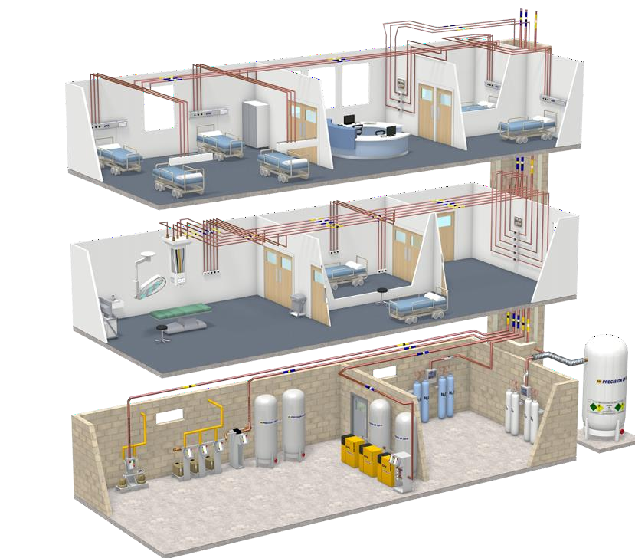
What Is Central Medical Gas Distribution System?
Medical Gas Distribution System is a central supply system to supply a medical gas (O2, N2O, N2), medical air, and medical vacuum to each ward of hospital safely and conveniently through a central supply piping from medical gas supply sources.
The system has a thoroughgoing color coordination according to the kind of gas.
An audio-visual monitoring system capable of checking the situation.

Slide 5
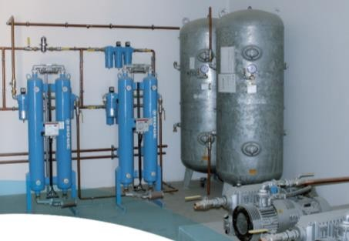
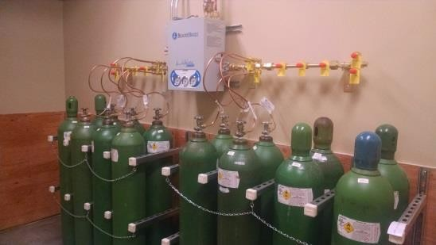
Advantages Of Centralized Medical Gas Delivery System
No distressing sign of oxygen cylinder at bed side.
Elimination of noise produced be their movement.
Protection of sterile areas from contamination caused by use and movement of cylinder.
Uninterrupted and clean gas supply at each workstation.
Safe And Relief System
Effective use of space. Additionally, it is economically advantageous and hygienic.

Slide 6
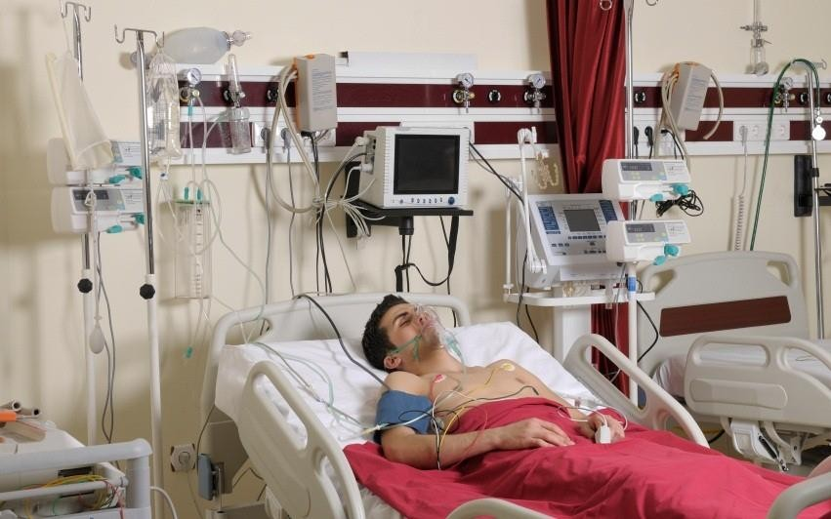
Types Of Medical Gases
Oxygen- used for respiratory therapy and life-support and is additionally used in anesthetic procedures.
Medical air-This is supplied by a specialized air compressor to patient care areas. Used extensively in the ICU, PICU, and NICU areas, to reduce the risk of excess oxygen in the lungs, during surgical procedures.
Surgical air is used, at a higher pressure, to power a variety of surgical tools and other devices.
Nitrous oxide is used for anesthetic and analgesic purposes.

Slide 7
Types Of Medical Gases
Helium/oxygen mixture is used to treat patients with respiratory or airway obstruction.
Carbon dioxide in used in the medical world to aid laparoscopic examination. The carbon dioxide inflates the stomach slightly which simplifies internal visibility inside the abdomen.
Piped vacuum or Suction is provided by means of centrally sited vacuum pumps & supports evacuation procedures.

Slide 8
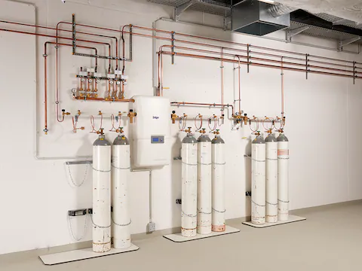
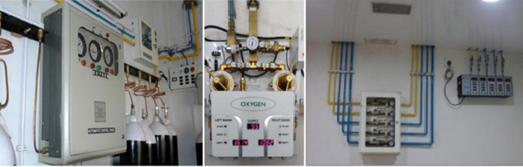
Medical Gas Pipeline System (MGPS)
Manifold room
Manifold control panel (analog)
Manifold control panel (digital)
Manifold alarm system (analog)

Slide 9
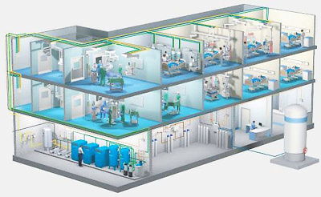
Fundamental Principles
Standards
Designed as per IS 7396, to withstand the pressure at every different section of the oxygen piping system
Color
Oxygen pipeline in India is painted either in white or painted in yellow with white colored patches throughout the pipeline
Pressure
Near the LMO plant : >15 bars
Wards and zones : > 5 - 7 bars
General delivery : 4-5 bars

Slide 10
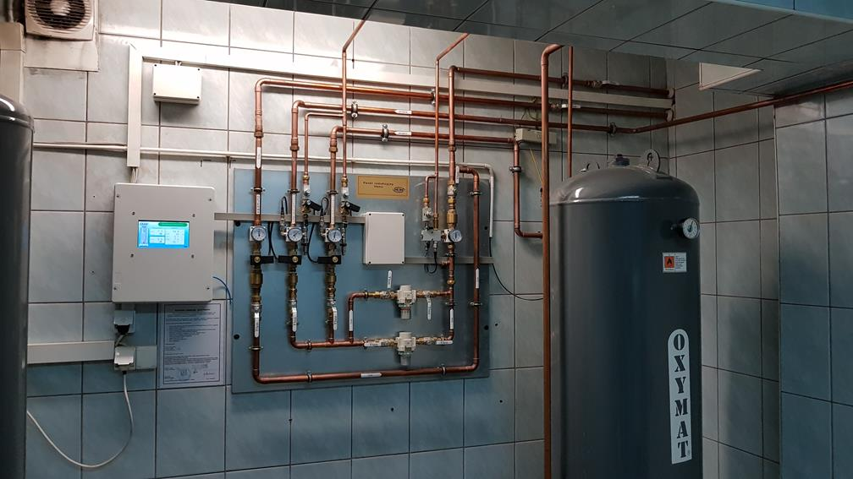
Fundamental Principles
Working
Oxygen pipeline system should gradually taper
If the pressure requirement at the delivery point is higher than the outlet pressure of the oxygen source, then pipe diameter should gradually decrease. Increment and decrement in MGPS pipe diameter is done according to the pressure regulation and pressure drop compensation.
Construction
Divided the pipeline system into different zones
Have pressure gauges to show pressure in the zones
Have a master alarm and zonal alarms if there is a drop in pressure

Slide 11
Components of MGPS

Slide 12
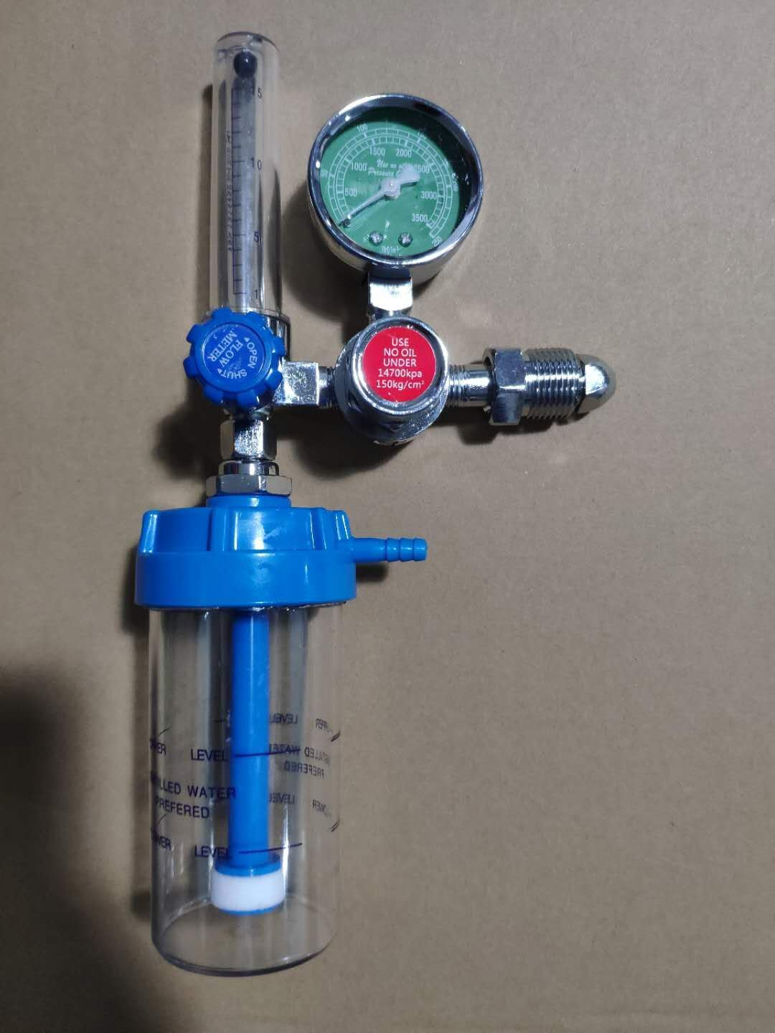
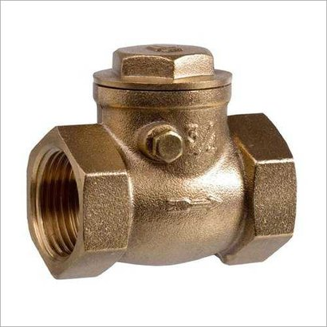
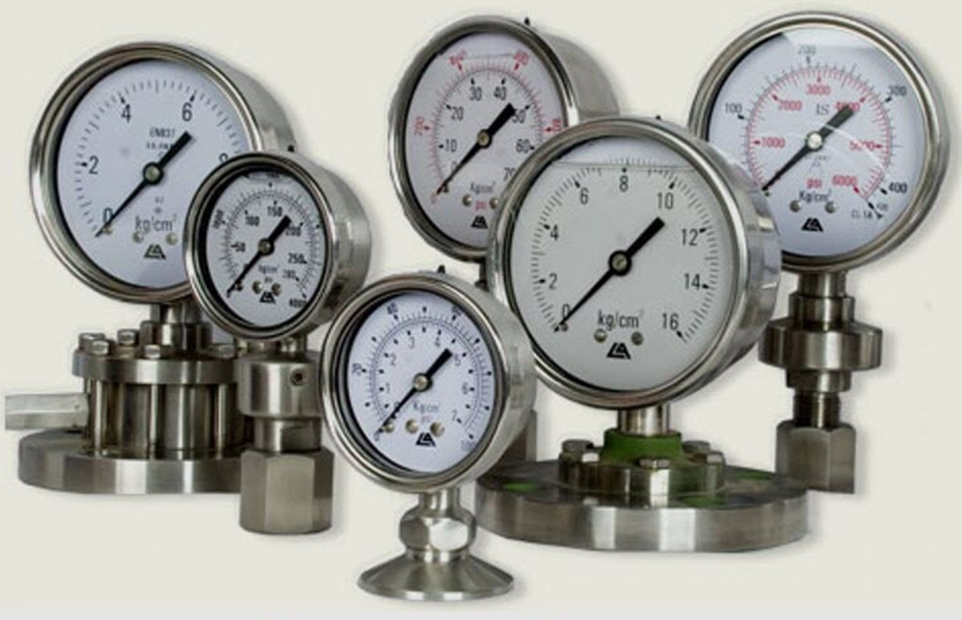
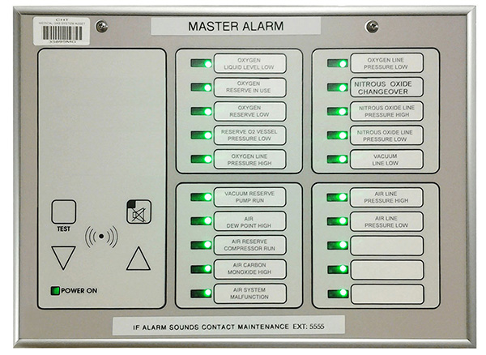
Components of MGPS
Pressure Regulatory Valve (PRV)
Non-return Valve (NRV)
Pressure Gauge
Master Control Alarm
The components should be in accordance with the IS 7396, as quality of these components are very vital in ensuring that oxygen pipeline system is able to meet the expectations

Slide 13
Sources
Sources are supplies that produce the flow of medical gases through piping networks. The four main sources for medical gases are:
Bulky Systems
It consists of special insulated vessels, vaporizers, and regulators
Manifold Systems
It consists of high-pressure cylinders on 2 banks, one is back up to other.
Medical Air Treatment Systems
These are 2 or more compressors equipped with a receiver, derivers, regulators, filters, dew point monitors, and carbon dioxide alarms.
Vacuum Pumps
The main control panel is installed for primary and secondary regulators, pressure regulators and warning lamps.
Oxygen, nitrous oxide and carbon dioxide are supplied to large hospitals in cryogenic tanks
Vacuum pumps are mechanized devices that create a negative pressure in the piping system
A reservoir tank is used for storage to permit cycling on and off

Slide 14
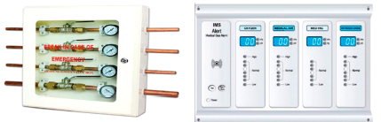
Valves
The 2 type of valves are:
Zone valves
Service valves
Zone valves are used to isolate large parts of the system i.e. rooms for modification and/ or repair Zone valves are placed on corridor walls and should be labelled to indicate the rooms they control
Service valves used to isolate certain part of the system for modification and/ or repair. They are accessible by the clinical staff.
Area valve service units (AVSUs) are placed in clinical sector to cutoff the gas delivery to the area beyond it during maintenance or to handle emergency
Area alarm panel (AAP) display the line pressures and have audiovisual alerts.
Area valve service unit
Area alarm panel

Slide 15
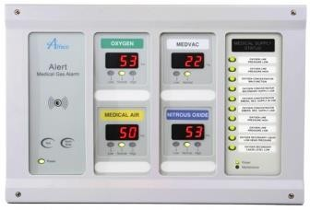
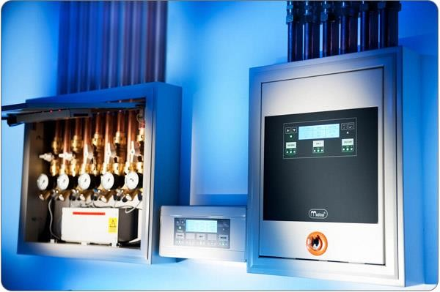
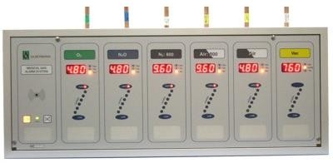
Warning And Alarming Systems
The 2 main alarm systems are
Master alarm
Area alarm
Master alarm monitors the main gas lines and sources conditions
Area alarms are found on alarm panels and their function is to monitor the condition of specific critical care area

Slide 16
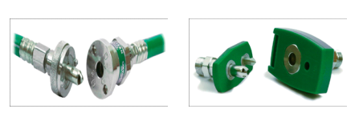
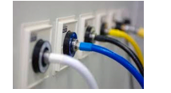
Outlets And Inlets
Diamond
Outlets are points to which connection can be made to the medical gas piping system to supply gases under pressure, while inlets are to supply vacuum
The final delivery points are color coded, incorporating either the diameter index safety system or are of the quick connect type available in two varieties
Diamond
Chemetron
Chemetron

Slide 17
Secondary Equipment
Hoses, gas flow meters, gauge and vacuum regulator can contribute substantially to gas and vacuum consumption
Check them as a part of routine inspection procedures

Slide 18
Session: Pipeline Distribution System, Safety, And Handling

Slide 19
Pipeline Distribution System Pipeline Testing

Slide 20
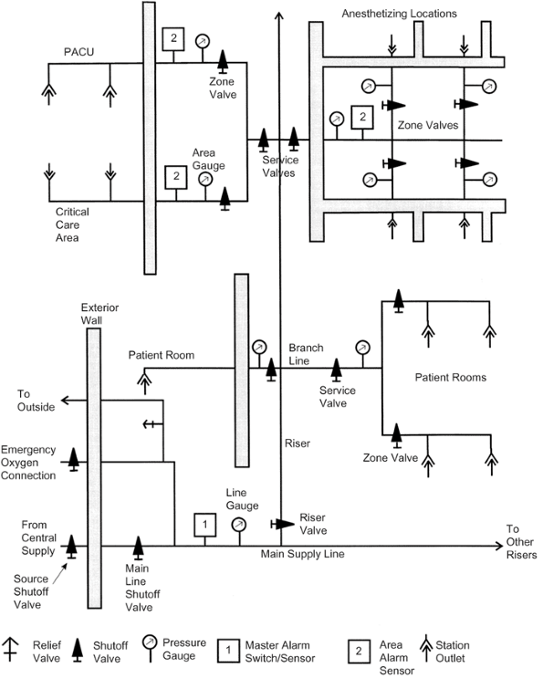
Main Lines
Riser Lines
Branch
Lateral Lines
Lateral Lines

Slide 21
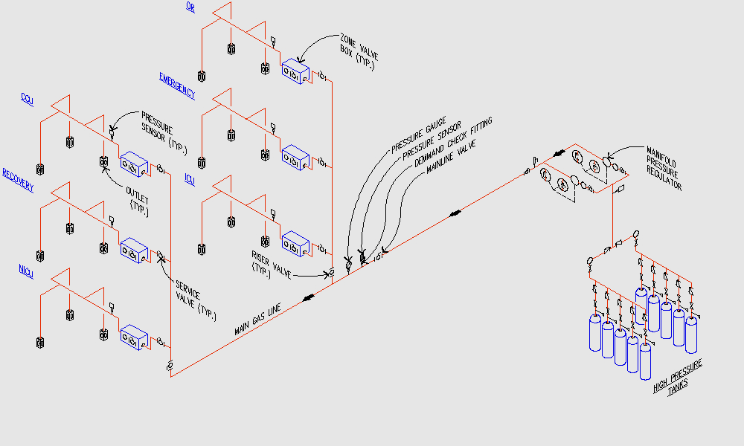
Layout Diagram Of MGPS

Slide 22
Pipeline Distribution System Design
Number of stations: Outlet/ inlets are often called “stations” for each specific gas type. It is estimated by the medical planner, or the architect based on the requirement of the facility.
Flow rates: The flow rate and diversity factors vary for individual stations depending on requirement (the total number of terminal units and the type of provided care). Pressure range is usually kept in between 4 bar to 4.2 bar.
Medical gas outlet/ inlet terminals: Various types of it are provided from different manufacturers. The terminals are available in various gas sequence center-line spacing, and concealed mounting

Slide 23
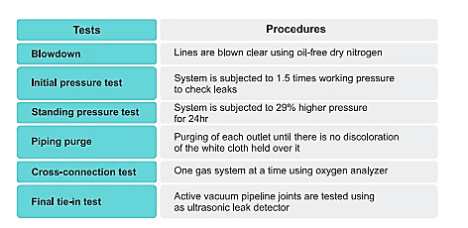
Pipeline Testing

Slide 24
Color Coding For Gas Pipelines

Slide 25
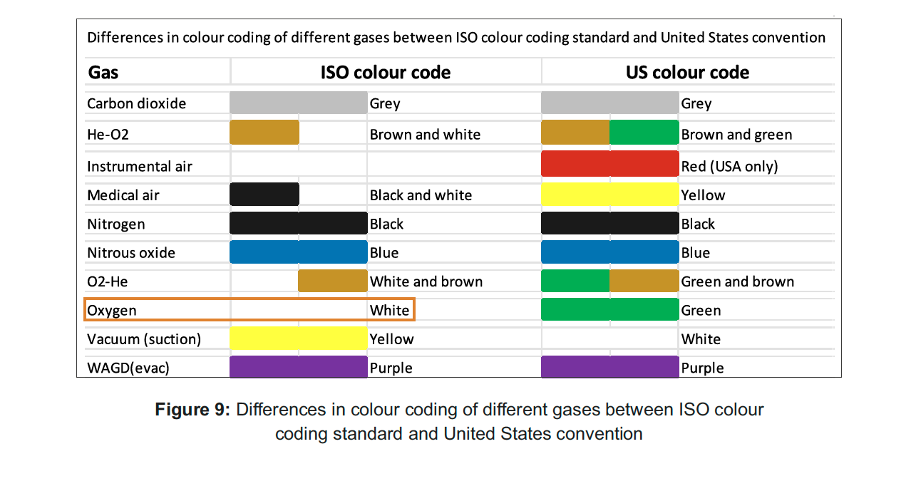
Color Coding For Gases
In MGPS
The international standard for the color coding of gas pipeline is ISO 32: 1977 Gas pipelines for medical use – Marking for identification of content.
According to the ISO standard, oxygen should be labelled as white.
The figure shows differences in gas pipeline color coding between ISO and US standards.

Slide 26
Usage of Medical Gases
The functional areas of the proposed building where in, the Medical gas shall be required is as follows:
Operation Theatre | O₂, N₂O, CA, MA, Vac
Cath Labs | O₂, CA, Vac
Intensive Care Beds | O₂, CA, Vac
Recovery Beds | O₂, CA, Vac
General Beds | O₂, CA, Vac

Slide 27
Safety and Handling of MGPS

Slide 28

Precautions with MGPS
Do not randomly add ventilators on your existing oxygen piping system
Consult a biomedical engineer / professional designer
Distribute new ventilators across the floor in the different sections of the oxygen piping
Construct a high-capacity oxygen piping from the plant from scratch and take it to the ICU unit
Train and appoint dedicated manpower across all shifts
There should be at least one person at any given point of time who understands the entire oxygen pipeline layout
Every ward or every zone should have zone or ward wise drawings of the MGPS with clear indication of pressure settings and valve positions
There should be display of the entire oxygen pipeline layout with pressure setting and the valve positions at centrally accessible places in hospitals

Slide 29
Safety Principles
Identity
Identity is assured using gas-specific connections throughout the pipeline system, including terminal units, connectors etc., adhere to strict testing and commissioning procedures of the system
Adequacy
Continuity
Quality of supply
It is achieved using gases purchased to the appropriate Ph. Eur. Requirements or produced by plant performing to specific standards, by the maintenance of cleanliness throughout the installation of the system, and by the implementation of the various testing and commissioning procedures.
Depends on accurate assessment of demands and the selection of plant appropriate to the clinical/ medical demands on the system
It is achieved by the specification of system that has duplicate components. The provision of alarm systems and connection to the emergency power supply system. Surgical air system are not considered to be life-support system and therefore duplicate components are not normally required, an emergency/ secondary supply is provided

Slide 30
Fire Safety
Fire detection system such as smoke or heat detector heads should be installed in the plantrooms, medical gases manifold rooms and medical gases cylinder stores in hospital
An automatic shutdown system, linked to local smoke detector can be installed
An automatic emergency supply manifold system is sited well away from the fire risk area and is arranged to come on-line automatically in the event of plant shutdown

Slide 31
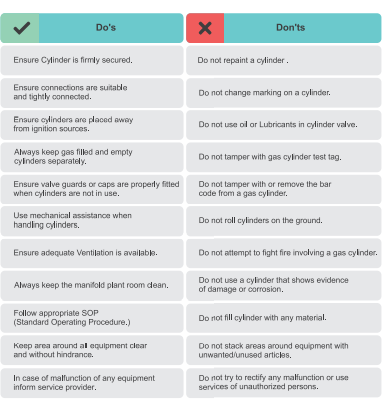
Precaution Handling MGPS
Formulating SOPs and maintaining logbooks
Preventive maintenance of equipment
Leak test of pipeline should be ensured on quarterly basis
24 hrs manning by trainer personnel
Periodic training of manifold personnel
Daily checking of contingency plan
Mock drills of pipeline failure, fire and explosion should be regularly conducted
Managing pressure of different sources so as to manage cumulative flow
Ensuring if all sources are contributing in a cumulative manner or any source is failing to supply oxygen due to pressure difference

Slide 32
Thank You!
This presentation was made possible with support from the United States Agency for International Development funded RISE program, under the terms of the cooperative agreement 7200AA19CA00003. The contents are the responsibility of the RISE program and do not necessarily reflect the views of USAID or the United States Government.​

